Slide 1

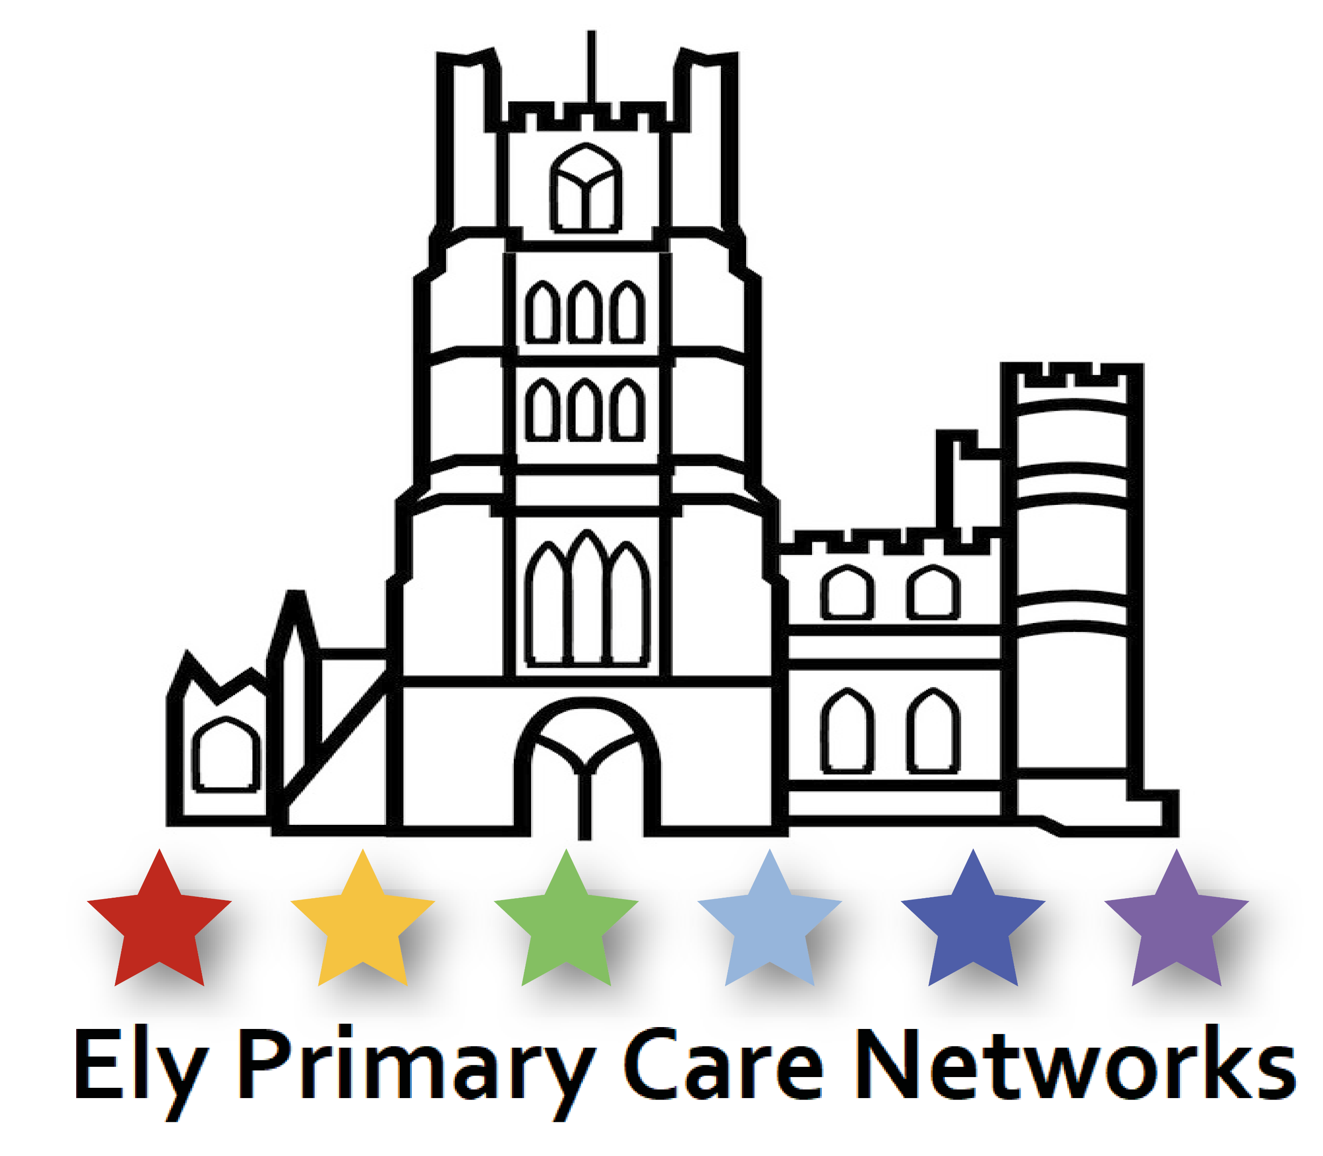

Integrated Neighbourhood Frailty Work in East Cambridgeshire
What we have built
and where we want to go

Slide 2
1. East Cambridgeshire
2. Ely Primary Care Networks
3. East Cambs Neighbourhood work
4. Mereside Medical Group frailty programme
Ashling Bannon – Neighbourhood Programme Manager
Kelly Chaplin – Mereside Frailty Lead
Simon Randall – General Manager, Ely PCNs

Slide 3
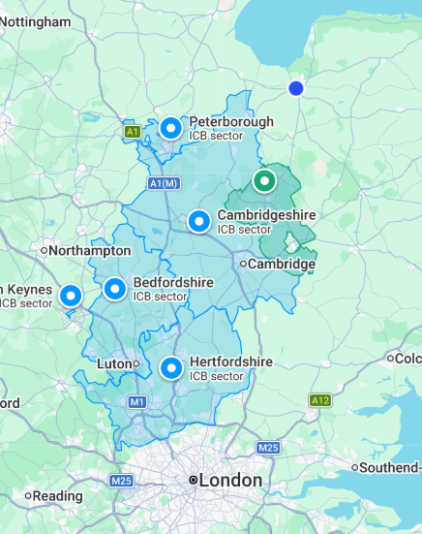
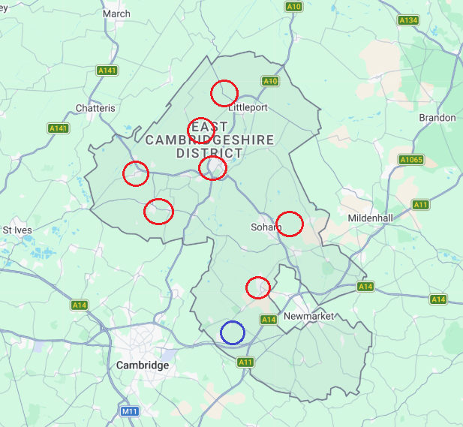
Two PCNs – ‘Ely North PCN’ &‘Ely South PCN’.
7 of the 8 GP practices in East Cambs.
90,000 registered patients.
Mereside Medical Group are 3 of the 7 Network Practices. 44,000 reg pts. (48%)
Cathedral
Haddenham
Staploe

Slide 4
East Cambridgeshire - demography 1
87,700 population (ONS 2022).
“East Cambridgeshire is a largely rural area, with 55% of residents living outside
of the three largest settlements (Ely, Littleport and Soham). This can make it more difficult for people to access services, especially those without access to a car or
public transport.” (East Cambridgeshire District Council Health and Wellbeing Strategy)
Our rurality and lack of public transport provides real challenges for residents in terms of access to health and care provision as well as access to social activities and connections which reduce loneliness and isolation.

Slide 5
East Cambridgeshire - demography 2
Asian and Black ethnic groups are underrepresented compared to national and county averages, though pockets of diversity do exist within the region.
East Cambridgeshire is generally one of the least deprived districts nationally, ranking as the 45th least deprived out of 317 English local authorities. However, significant localized deprivation exists, with pockets of poverty and challenges concentrated in urban and rural areas like Ely, Littleport, and Prickwillow.
3.7% population provide more than 20 hours of unpaid care per week.

Slide 6
East Cambridgeshire – significant population growth expected
People aged 65 and over make up roughly 19% to 20% of the total population in East Cambridgeshire. The older population varies significantly across the district, ranging from 13.0% in the Ely North ward to 25.8% in the Bottisham ward.
Between 2011 and 2021 “The number of people aged 65 to 74 years rose by just under 2,200 (an increase of 28.6%).” (ONS Census analysis Jan 2023). Population projections show that by 2043 people ≥65 will make up 30% of the population in East Cambs.
East Cambridgeshire is among the fastest growing districts in the country; the new Local Plan proposes 10,835 new homes between 2016 and 2036.
3.7% population provide more than 20 hours of unpaid care each week

Slide 7
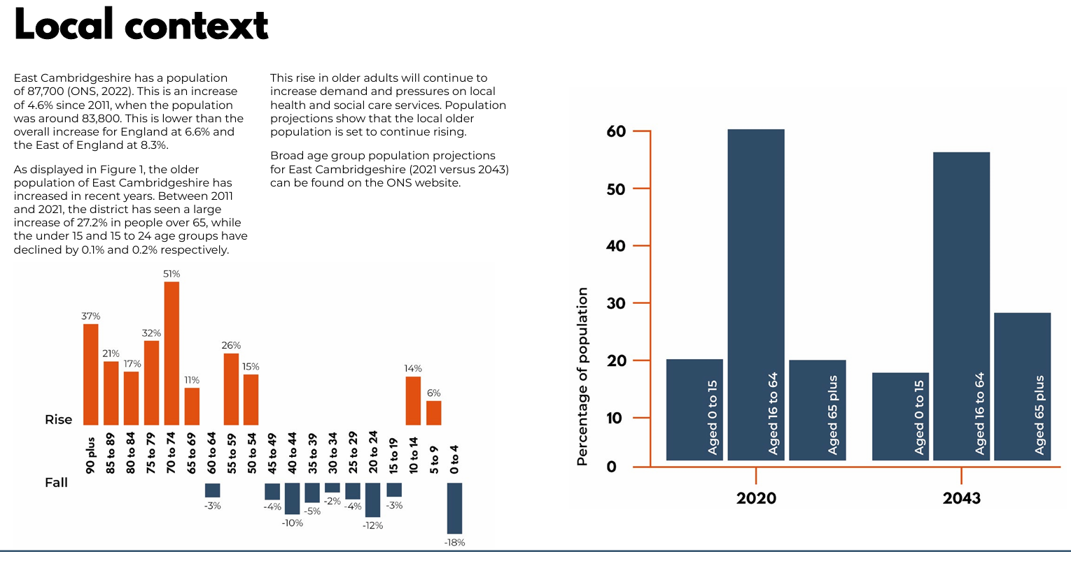
East Cambridgeshire
East Cambridgeshire District Council Health and Wellbeing Strategy
https://eastcambs.gov.uk/sites/default/files/2024-10/Health%20and%20Wellbeing%20Strategy.pdf

Slide 8
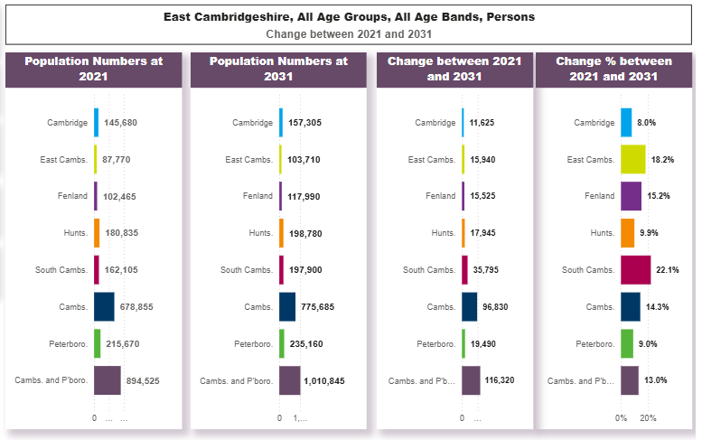
East Cambridgeshire
https://cambridgeshireinsight.org.uk/jsna-2023/demography/predicted-future-change/
East Cambs has the second highest population growth predicted after South Cambs
18.2% (2021 – 2031)

Slide 9
Ely PCNs
A joint Board and shared leadership with a GP Partner representing each of the 7 practices.
Two Clinical Directors (Dr Zoë Hutchinson & Dr Richard Brixey).
A GP Lead for Frailty – Dr Jo Baker.
Invested early in managers and Team Leads.
Close working arrangements with Neighbourhood Leaders.
Signed up to a way of working, and role generosity.
Track record of innovation in response to patient need.
Identified MYCaW as an outcomes measurement tool.
Full, often shared, ARRS staff complement.

Slide 10
Ely PCNs Org Chart – July 2026
Personalised Care Team
First Contact Physios
Health & Wellbeing Coach Ely North
Social Prescriber
Sutton & St Mary’s
Pharmacy Team
General Practice Assistants
MH Connector
Ely South
First Contact Physio
Health & Wellbeing Coach Ely North
Social Prescriber
St Mary’s
Pharmacy Tech
Clinical Pharmacist
GPA 1 St George’s
Social Prescriber Acorn
Pharmacy Tech
Clinical Pharmacist
First Contact Physio
GPA 2 St George’s
MH Connector
Ely North
Health & Wellbeing Coach Ely North
Social Prescriber St George’s
Safeguarding Coordinator
St Mary’s
Pharmacy Tech
Clinical Pharmacist
First Contact Physio
GPA 1 St Mary’s
Neighbourhood Carers Lead
Health & Wellbeing Coach Ely South
Social Prescriber Staploe
Pharmacy Tech
Clinical Pharmacist
GPA 2 St Mary’s
Safeguarding Coordinator
St Georges
Health & Wellbeing Coach Ely South
Pharmacy Tech
Clinical Pharmacist
First Contact Physio
Student Nurse Associate
Burwell
Social Prescriber Haddenham & Staploe
GPA 1 Cathedral
Infant Feeding Coach
Pharmacy Tech
Clinical Pharmacist
First Contact Physio
GPA 1 Staploe
Occupational Therapist
Safeguarding Coordinator
Mereside
Infant Feeding Coach
Social Prescriber Burwell
Pharmacy Tech
Clinical Pharmacist
Lead First Contact Physio
GPA 2 Staploe
Lead Pharmacist
Recovery Coach
Lead Health & Wellbeing Coach
Lead Social Prescriber
GPA Haddenham
Service Manager Enhanced Access & Vaccination Prog
Personalised Care Team Lead Prac
Integrated Neighbourhood Project Manager
Integrated Neighbourhood Programme Manager
PCN & Neighbourhood Administrator
Assistant PCN Manager
PCN Manager
Clinical Projects Lead
Practice Manager rep
PCN GP Lead
for Frailty
PCN GP Lead for
Mental Health
Operations and
Leadership Team
Clinical Director
Ely North
Clinical Director
Ely South
GP Partner
St George’s
GP Partner
St Mary’s
GP Partner
Cathedral
GP Partner
Staploe
GP Partner
Haddenham
GP Partner
Burwell
PCN Board

Slide 11
Secret Sauce
Early investment
Have taken opportunities
ARRS staff, management, Team Leads
Innovation bids
Relationships
Leadership team that have come to respect one another.
Good working relationships, often forged working together on specific projects.
High levels of trust across Neighbourhood.
Shared aims
Role generosity.
Pooled budgets for projects and posts.
Courage and boldness
Feels safe to try things and learn, and risk getting things wrong.
Bold enough to experiment, not waiting for the perfect plan.
Systems Leadership idea of iteration.

Slide 12
Challenges
Future of PCNs and Neighbourhood contracts.
Invested in creating a CQC-registered incorporated company (ltd by shares to sit alongside the two PCNs) in readiness.
High quality population health data.
to really know our hyperlocal areas of inequality & and patient risk.
Robust information governance.
Robust legal methods of data sharing and gathering outcomes from agencies across the Neighbourhood.
Measurement
Measuring whether we’re making a difference. MYCaW.

Slide 13


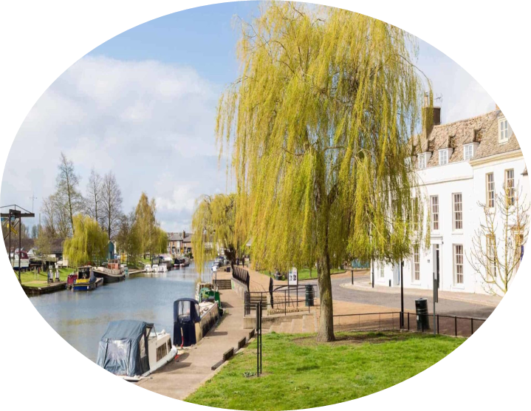
East Cambridgeshire Integrated Neighbourhood-
Ageing Well Programme
July 2026

Slide 14

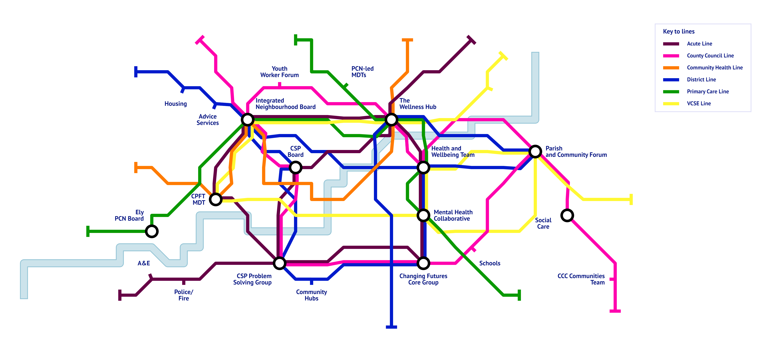
East Cambridgeshire Integrated Neighbourhood Underground System
Our underground system of forums, networks and collaboratives continue to strengthen the foundation of our Integrated Neighbourhood.
Our map reflects the interconnections and interdependences between subsystems powering our way of working but also represents the complexity of navigating these subsystems, experienced by people living and working in East Cambridgeshire. Appreciating this will enable us to continue to think differently about co-production, pathways, reducing duplication and making better use of expertise and skills.
Notes:
Our map reflects how complex, complicated and messy systems working is - how difficult it is to naviagate our system and subsystems for people who live and work in our Neighbourhoods and perhaps similar across the Country. – building relationships with people across these interconnections and interdependences, boards , networks and forums is the foundation of our way of working

Slide 15
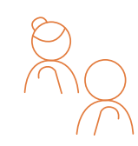
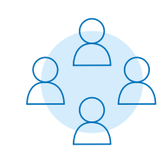
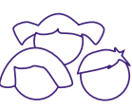

Our East Cambridgeshire Neighbourhood Way of Working.
This has been established through a relational way of working- -building our Team of Teams through:
A network of multiagency boards, collaborative and forums – monthly Locality Exec Board
Trust and role generosity
Shared principles and priorities – local data sets, partner and community knowledge, research in practice
Pooled budgets and joint posts
A focus on what matters most to individuals and communities
Integrated workforce development programme
Measuring what matters
This way of working enhances our understanding of the specific local health and wellbeing needs of that population and identification of people or groups most in need (that don’t often appear on dashboards and datasets).
By doing this, truly proactive and personalised care can be delivered to support people to live happier, healthier and safer lives within well-connected communities – preventative, proactive and multiagency
We have the following workstreams which help to structure the work of the Integrated Neighbourhood:
Starting Well
Living Well
Ageing Well
Operating Well

Slide 16

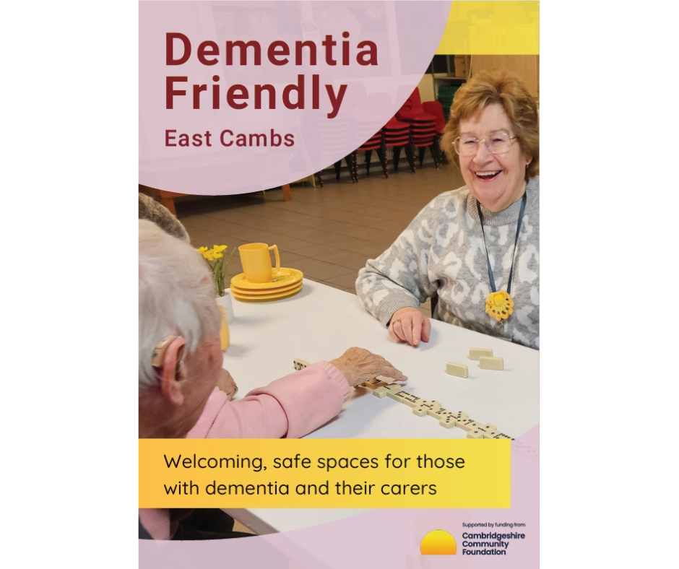
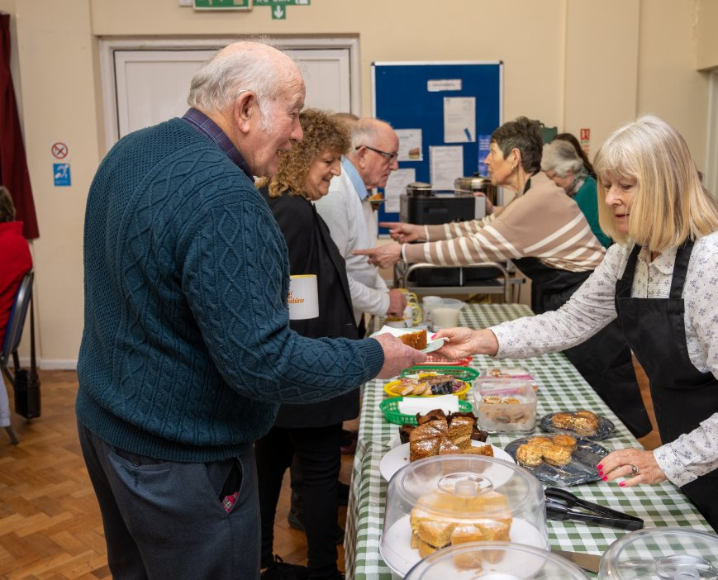
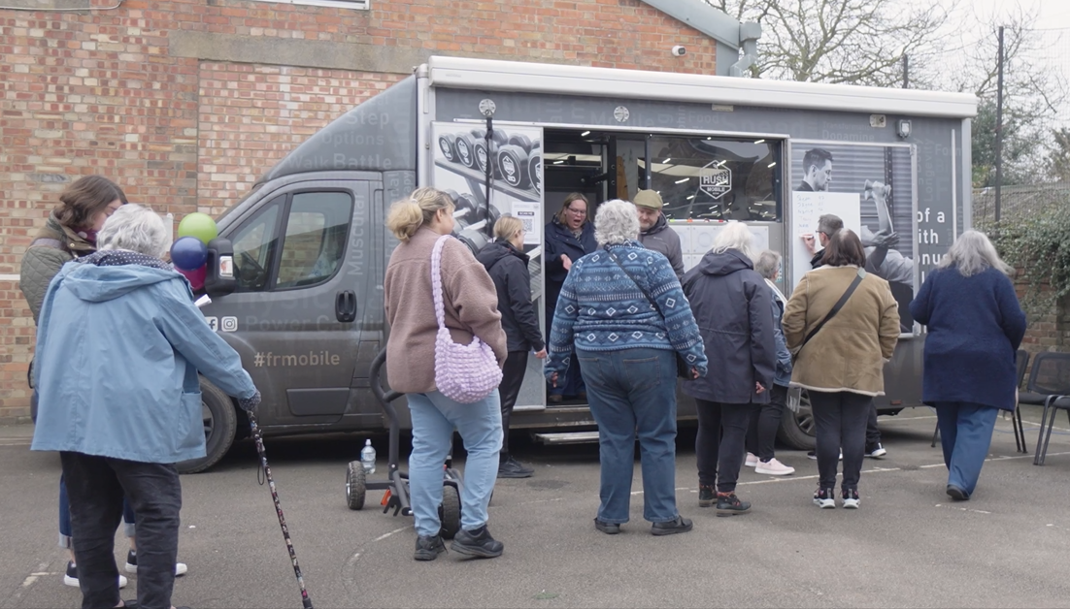
Ageing Well and Frailty in East Cambridgeshire
What challenge/need are we trying to meet?
Our aim:
For older people, and their carers, to live happier, healthier and safer lives, as independently as possible, for as long as possible, in their own community.
The challenge/problem: what were we trying to change?
The increasing number of people over 65 with:
complex health and care needs
having multiple contacts with multiple services in an unplanned way across East Cambridgeshire
Image Credit: Cambridgeshire Acre

Slide 17
The cohort: who did we support?
Cohort 1
People with moderate Frailty ( Efi 0.25-0.36 or Clinical Frailty Scale (CFS) (Rockwood) 6-7)) and >5 ED attendances or mild -moderate frailty (EfI 0.13-0.24 or CFS 4-5) and > 5 ED attendances and at least one of the following >3 Long Term Conditions (LTC) or severe respiratory disease
Cohort 2
Last 12m >5 ED attends or frequent use/ attendance of OOH services or partner services such as GPs, 111, ambulance, mental crisis team, housing or social care and at least one of the following – multiple LTCs, sever respiratory disease or mental health condition
Cohort 3
People over 50, who without proactive care and support, are likely to become frail and/or develop increased health and care utilisation
Ageing Well
Operating Well
Living Well

Slide 18
So, what did we do?
East Cambs Ageing Well Programme - Support Strands and Universal Offer
Under the umbrella of our Ageing Well Programme there are currently 8 strands of support in operation with 2 more planned All of which are:
enabled by incredible collaboration and generosity from our partners and communities, and
focused on what matters to the person as opposed to what the system believes the person needs (that is often limited by service availability).
Carers Proactive and Personalised Care and Support activity | Community Hubs and Village Agents | Specialist OT Activity (Med3 and Employment)/ | Community Appointment Day (s) | Personalised Care Team ( over 65) | S1 Searches and related activity | The East Cambs Wellness Hub | Active for Health | Being developed 1. Neighbourhood Coordination Junction 2. Radar Clinic and Falls Prevention
All individuals supported by The East Cambridgeshire Ageing Well Programme, (irrespective of support strand) can benefit from any of the following opportunities:
a "What Matters to You?" conversation
personalised care and support planning
Completion of MYCaW outcome measure; and
when indicated and subject to consent referral to the East Cambridgeshire Wellness Hub and small personal budget

Slide 19
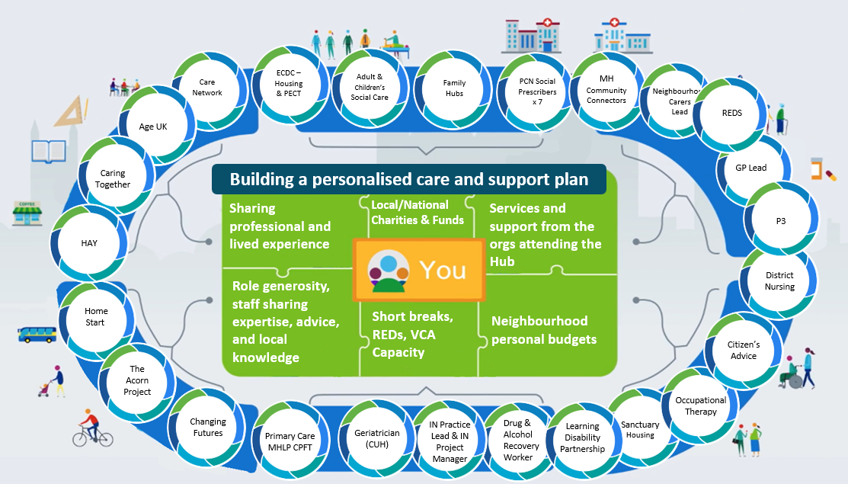
The East Cambridgeshire Wellness Hub

Slide 20
Wellness Hub – What Happens on a Tuesday
Where? | Meets Tuesday 1-4pm at Gemini House in Ely
Who? | Fortnightly Wellness Hub ( Multiagency Solution Finding Forum ) Wide range of local partners Supporting up to 15 people per Hub – covering both new people for discussion and updates on how people already being supported are
What? | Share ideas, explore the widest possible range of resources, make decisions together Health Checks, Meds & LTC Reviews, vaccinations & benefits checks where needed Co-created Personalised Care and Support Planning, shared with individual’s consent Progress/outcomes of people previously referred are shared, discussed again (if needed ) Data collected for research and evaluation purposes
How? | Explicit permission and consent is recorded by the Presenting/Lead organisation Hub is led by our Neighbourhood Practice Lead – Senior Social Worker Lead/Presenting Organisation holds case responsibility Personalised Care and Support Planning held by lead organisation Information shared across Mosaic, SystmOne, Charity Log, EPIC, HomeLink etc.
Why? | Draw in specialism & expertise when needed, keeping’ referrals’ & handoffs to a minimum Shared risk taking and responsibility – One Team Strong foundation for scaling Neighbourhood working – impacts on wider population
Solutions
Roles
Mistakes
Learning
Ecosystem
Communications
Outcomes
Data
Risk taking
Responsibility
Priorities

Slide 21
East Cambridgeshire Ageing Well Programme: What impact are we making?
How our work is impacting on the System:
Proactively contacted and provided personalised care and support planning to 643 people in 25-26 with mild-moderate frailty and/or complex health and care needs
Out of a sample of 133 people -86% reported sustained improvement in their primary concern, 82% reported sustained improvement in their secondary concern and 80% reported sustained improvement in their overall wellbeing
Reduced unplanned hospital admissions by 16% in 25-26
71% reduction for admission related costs in Ely South PCN footprint in 25-26
Sponsorship and support from the National Association of Primary Care – Using changes in MYCaW score to calculate RoI for our personalised care approach in terms of health utilisation

Slide 22
East Cambridgeshire Ageing Well Programme: Overview of MYCaW scores
 | Concern 1 | Concern 2 | General Wellbeing
Number completed pairs of pre and post MYCaW data | 133 | 89 | 133
Mean change in scores | -2.6 greater change than overall PN population average (-2.1) | -2.6 greater change than overall PN population average (-1.9) | -1.6 greater change than overall PN population average (-1.3)
Is this change statistically significant? | Paired t test – applying a cut off value for statistical significance of p=0.05 P=>0.01 implying high significance and therefore the null hypothesis: ‘There is no difference between pre, and post scores’ can be rejected. The change in scores are statistically significant* *acknowledging Concern 2 has fewer than 100 paired data sets, so there is insufficient data to draw a powered-analysis conclusion
% of participants showing improvement | 86% | 82% | 80%
% of participants showing no change | 13% | 17% | 16%
% of participants showing deterioration | 1% | 1% | 4%
Changes in MYCaW of over 0.7 – 1.0 imply clinical significance (Paterson, 1996; Seers et al, 2009).
Notes:
Compared to the whole Proactive Neighbourhoods cohort:
Average pre-support MYCaW scores were higher
Mean score changes were greater
% of participants showing improvements was higher and lower for no change and deterioration
**Changes in MyCaW of over 0.7 – 1.0 are likely to be clinically significant Paterson C. Measuring outcome in primary care: a patient-generated measure, MYMOP, compared to the SF-36 health survey. BMJ 1996; 312: 1016-1020.
Seers, H. E., Gale, N., Paterson, C., Cooke, H. J., Tuffrey, V., & Polley, M. J. (2009). Individualised and complex experiences of integrative cancer support care: combining qualitative and quantitative data. Supportive care in cancer, 17(9), 1159-1167.H29

Slide 23
East Cambridgeshire Ageing Well Programme: What have we learnt?​
Appreciative Enquiry with older people across East Cambridgeshire​ - What Matters Most
A Place to call home
A sense of purpose
Family and friends
MYCaW shows the improvements people have made to their own health and wellbeing
Appreciative Enquiry with our Integrated Neighbourhood Workforce. Our way of working:
Improves mental wellbeing –staff can see that their work is making a difference through MYCaW
Improves mental wellbeing – staff can see that they are providing the best possible offer of support based on what matters most to the person
Consistency of language and approach helps buy into our way of working
Our way of working reduces referrals, handoffs and significant time saved chasing emails and contacts
Meeting f2f with shared learning and training opportunities means people identify as one team
Sharing risk and responsibility creates safety to work as one team.
Need for increased adoption of Clinical Frailty Scale across organisations and clinical and non-clinical workforces

Slide 24
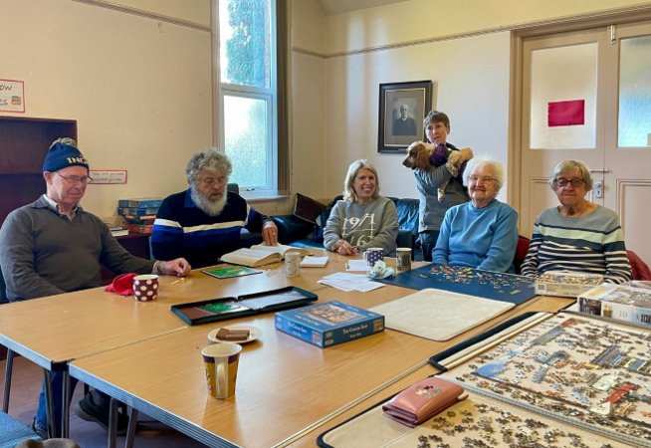
Progressing our Ageing Well Programme in East Cambridgeshire
Ageing Well Team maturation
Increasing the number of older/frail people that we proactively support with personalised care and support planning – Target 3%
Test and Learn Pilots
  Support for people on memory assessment waiting lists and their carers (including a Community Appointment Day for people on memory assessment waiting lists and their carers, scheduled for Autumn)
  Neighbourhood Coordination Junction: Proactive contact with people/carers/system partners on admission and approaching discharge to maximise system capacity and continuity of care
Clinical Frailty Scale training and rollout
Neighbourhood Ageing Well and Frailty Workshop
Supporting role out of Mereside Medical Frailty Team across the neighbourhood

Slide 25
Ely PCNs & Mereside Medical
Integrated Neighbourhood Frailty Programme
Building proactive frailty care across our PCNs
90,000 patients I 7 practices I 10+ years of development
“We are not starting from scratch. We are building on a decade of proactive frailty care.”

Slide 26
The Problem
As demand continues to increase, reactive care alone is no longer sustainable
Our patients experienced:
Fragmented care
Multiple unplanned hospital admissions
Poor transition after discharge
Delayed identification of deterioration
Limited advance care planning
Variation in access to frailty support

Slide 27
Our Cohort
Who are we supporting?
People living with moderate and severe frailty across Ely PCN, including:
Care home residents
Housebound patients
Patients identified through eFI and frailty registers
Patients requiring Comprehensive Geriatric Assessment (CGA)
Patients approaching end of life
Population covered
90,000 patients
7 GP practices
18 care homes
522 care home residents

Slide 28






What we have built – the aim was simple; identify frailty early, intervene proactively and support patients to remain well at home
GP & ANP
Frailty Team
Welcome
Home
CUH
Partnership
Dedicated GP lead + ANPs at 3/7 practices delivering CGAs, proactive care planning & home visits
Within 48hrs of discharge, every frail patient proactively contacted — across 3 practices, funded by Mereside
Monthly neighbourhood team meeting with CUH geriatricians & CPFT psychiatry. Care home team across 18 homes
Neighbourhood
Team Meeting
RADAR
Clinic
Social &
Voluntary
Fortnightly problem-solving meeting running 3 years — frailty, complex cases, WMTY conversations
Rapid-access geriatrician clinic at Princess of Wales, Ely — typically within one week
Social Prescribers, Carers Lead, and Proactive Care Lead (social worker) embedded in the neighbourhood team

Slide 29
Our Model
4. Intervene
Medication reviews
Falls prevention
Social prescribing
ACP / ReSPECT conversations
5. Follow Up
Welcome Home post-discharge support
Ongoing proactive reviews
1. Identify
eFI case finding
Practice frailty registers
Care home surveillance
2. Assess
Comprehensive Geriatric Assessment (CGA)
3. Coordinate
Fortnightly neighbourhood MDT meetings

Slide 30
Comprehensive Geriatric Assessment
CGA is a cornerstone of our proactive frailty care.
We aim to give every patient who is referred to us a CGA
A CGA provides a structured, evidence-based assessment of:
Physical health
Mental health
Functional ability
Social circumstances
Falls risk
Medicines optimisation
Advance care planning

Slide 31
Comprehensive Geriatric
Assessment
Comprehensive Geriatric Assessment
- medication review and optimisation
Care home residents
All care home residents receive an annual structured multidisciplinary medication review (SMR).
Reviews include the home’s care team, the named link GP who is responsible for the residents in each home, a PCN clinical pharmacist, an advanced nurse practitioner, and a geriatrician whenever possible.
Community patients
For frail patients in the community, following a CGA, an SMR by the clinical pharmacy team is requested and completed, and medications are further optimised focusing on areas of concerns from the patient (polypharmacy, dysphagia, falls etc).
All frail patients
Will have an additional medication review undertaken by their named GP as part of their annual long-term condition review.

Slide 32
Comprehensive Geriatric Assessment
- Advanced Care Planning / ReSPECT
Don’t be scared to talk about death; everyone dies!
Every patient who comes into the frailty service will be offered the opportunity to discuss their wishes regarding advanced care planning and ReSPECT.
The BGS End of Life Care in Frailty guidance is explicit: “severe frailty should be
recognised as a condition in which end of life is a possible, and often probable,
outcome. ReSPECT documentation, Gold Standards Framework triggers, and
active palliative care integration are standard components.”
Most people with frailty currently die without ever accessing specialist palliative care.

Slide 33
Evidence of Impact
What has changed?
More patients receiving proactive assessment
Earlier identification of deterioration
Increased ACP and ReSPECT completion
Improved coordination between organisations
Faster post-discharge follow-up
Better support for care homes
"Having access to a frailty service that is responsive, knowledgeable and supportive gives us reassurance and confidence..."
— Care Home Feedback

Slide 34
Evidence of Impact

Slide 35
Evidence of Impact
Documented ACPs have increased five-fold – a substantial increase in proactive patients for patients living with severe frailty

Slide 36
What We Have Learned
Our most effective elements of the model are:
Dedicated frailty clinicians
Regular neighbourhood MDTs
Integrated Care Home support
Early post-discharge contact (48hrs max)
Integrated working with social care and voluntary sector
Systematic ACP and ReSPECT conversations
Population-level frailty identification
All are easily widened and transferable across other neighbourhoods

Slide 37
Current Gaps
Frailty ANP Capacity – currently only available at Mereside in 3 of 7 PCN practices
Welcome Home – currently only available at Mereside in 3 of 7 PCN practices
Falls & Exercise Provision - current offer does not fully meet evidence-based recommendations
Operational Infrastructure - limited management capacity restricts scale-up.
District nursing – ever closer working - DNs are key!

Slide 38
Next Steps
Improve preferred place of death recording
Strengthen physiotherapy provision
Expand exercise programmes
Improve access to SALT, dietetics and mental health support
Continue development of integrated neighbourhood care
Working ever more closely with District Nurses.

Slide 39
What we propose
1. Commission a neighbourhood frailty programme.
2. Extend successful interventions across all 7 practices.
3. Create a sustainable commissioning baseline.
4. Evaluate outcomes over a three-year period.

Slide 40
Why Ely PCNs?
The Ely Neighbourhood Approach - the right care, from the right team, at the right time
10+ years of proactive frailty work
Established MDT infrastructure
Existing care home partnerships
Proven ACP improvement
Population stratification already embedded
Governance structure already in place

Slide 41
Ashling Bannon – Neighbourhood Programme Manager
ashling.bannon@nhs.net
Kelly Chaplin – Mereside Frailty Lead
kelly.chaplin3@nhs.net
Simon Randall – General Manager, Ely PCNs
simon.randall@nhs.net

